Slide 1

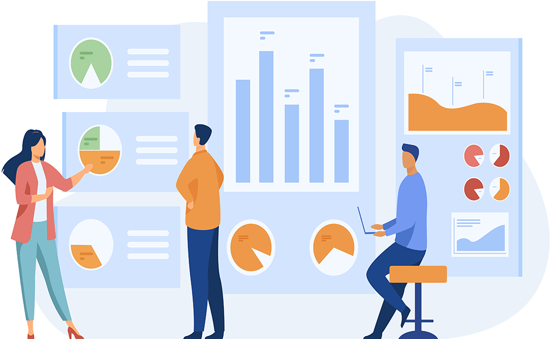
Data Science practices
Flairminds
Innovation, Resilience, Efficiency

Slide 2


Agenda
What is Data Science:
Introduction to Data Science
Potential value addition
Flairminds’ approach and experience:
Approach at Flairminds
Predictive tools at Flairminds
Technology and capabilities at Flairminds
Case studies
Contact
Confidential - Work Document

Slide 3
What is Data Science?

Slide 4

What is Data Science?
Data sciences is a study of data gathered from various part of life or various existing business in order to gain certain actionable insights or address specific business problems or research used for making business decisions.
This collected data is analysed and studied using various tools, analytics and algorithms
The primary objective is to find patterns and create predictive models leading to meaningful insights help business leaders to take more informed decisions.
Examples of this work would be
Analyze churning rates
Automation of extracting specific information from digitized documents
Predictive analysis of behaviours
predictive analysis of frauds or transactions
Enhance efficiencies of market or competitive product analysis helping in enhancing product quality.
Confidential - Work Document

Slide 5
Potential value addition
Customer
Distribution
Product
Pricing
Customer profiling
Customer segmentation
Acquisition Strategy
Next best action
Retention, Renewal, Lapse prediction
Customer Experience
Performance
Supplier analytics and Segmentation
Sales Lead
Pipeline Forecasting
Producer Retention
Web Journey / Omnichannel Effectiveness
Channel Optimization
New Product Development
Portfolio Management
Underwriting Risk Selection
Product Analysis
Loss Control
Optimising Underwriting Cycle
Automated Rules Engine
Market and Competitive Research
Exposure / Policy level Pricing
Segmentation
Real Time Price Optimization
Pricing Elasticity
Competitive Pricing
Confidential - Work Document

Slide 6
ML across businesses
Retail
Finance
Healthcare
Energy
Auto-pricing
Pricing optimization
Product matching
Marketing campaigns optimization
Product promotion optimization
Product replenishment optimization
Customer profiling
Customer segmentation
Predicting inventory
Similar products
Recommendation engines
Algorithmic trading
Making investment predictions
Fraud detection and prevention
Portfolio management
Loan underwriting
Process automation
Customer data management
Decision-making
Customer service level Improvement (Chat bots)
Personalized medicine
Detecting fraud in healthcare claims
Identifying diseases and Diagnosis
Medical imaging diagnosis
Machine learning-based behavioral modification
Smart health records
Clinical trial and research
Predictive maintenance
Grid management
Demand and load forecasting
Reduced energy consumption
Reliable renewable energy forecasts
Energy source exploration
Optimize prices through better trading
Confidential - Work Document

Slide 7


Approach at FlairMinds
The data science projects are agile by definition and with an iterative logic It would be necessary to do multiple iterations before having a final working model for industrialisation
>
Creation of variable
Preliminary analysis
Model selection
Comparison of algorithms
Business integration
Data
Preparation
Modelisation
Data Visualization
Business integration
>
>
Business integration
CSV
ETL and
pre-processing
Evaluation
Industrialisation
Excel
Extract Transform and Load the different data sources
Determine the schema and data structure
Business integration
DB with results
Analysis of the existent
Evaluate the data quality
>
Performance measurement
generalisation
Recette standard
Business Insights
Performance monitoring
SQL
Preparation
Model
Industrialization
Confidential - Work Document

Slide 8




















Data ecosystem & Services at Flairminds
Ecosystem:
Services:
STORAGE
ANALYSIS
MODEL
VISUALISE
Data Scientist
Data Analyst
Data Engineer
Business Analyst
Project Manager
Delivery Lead
PLATFORMS & DEVOPS
IT
Systems Architect
Confidential - Work Document

Slide 9
Technologies at Flairminds
Methodology | Description | Tools capability @ Flairminds
Machine learning | Read hidden patterns to learn and improvise the system | Scikit_learn, ML algorithms such as - Linear regression, KNN, Random forest, SVM, XGboost etc
Predictive analysis and visualization | Identify the likelihood of future outcomes based on historical data | ML algorithms, Azure ML. Data studio, Power BI, Tableau, Seaborn
Natural language processing | Analysis and synthesis of natural language and speech which makes human language decipherable to computer | Spacy, NLTK, Gensim, TF-IDF, Word2vec, Word2doc, Bert, FAISS
Object detection and image processing | Sorting image objects by detection, tracking and classification using computer vision | TensorFlow, Transformer, Pyspark, FAISS, OpenCV
Deep learning | A neural network that attempts to simulate human brain | Pytorch, TensorFlow, Theano, Pyspark, FAISS, OpenCV, Transformer
Big data analytics | Uncover trends, patterns and correlations in large amount of raw data | MongoDB, Azure, Google cloud, AWS, Apache spark, Tableau
Cloud services | Cloud architecture for model deployment and APIs | Azure, AWS, Google Cloud
Confidential - Work Document

Slide 10
Case studies

Slide 11




Global spirits manufacturer
Objective: Optimization of sales through classification & recommendations of products
Outcome: 10% increase(2M €) in spirits sales volume in France as a result of solution developed
Data Sources
Data Processing
Visualization
PoS data (Daily update)
Data cleaning
Data model
Analysis
Address normalization using regex
Build/refine the product catalogue
Connectors to ingest data from different sources
Defined data model
Storage in data lake and sql server
Python API to feed results to live dashboard
Segmentation model to classify stores in 10 categories
Ranking model to prioritise different products for sales recommendation
Dashboard Power BI
Promotions data
Socio-demographic data
Some extracts in Excel format
Confidential - Work Document

Slide 12

Insurance fraud detection
Objective: Prevent and detect the deceitful claims without affecting customer experience
Outcome: A million claims analysed on daily basis across top 100 insurance carriers across the world
Data Sources
Data Processing
Visualization
Policy and claims
Data cleaning
Data model
Analysis
Data anonymization
Phonetic model for name normalisation
Image data cleaning
Defined data model for data collection
Storage in SQL server
Model for image similarity and metadata analytics for images
Graph based model to create relationship between entities
Ranking model to score claims based on fraud probability
Subscription information
JS based frontend
Historical claims data
Deployment on self managed infrastructure on Azure
Confidential - Work Document

Slide 13


Leading European retailer
Objective: User segmentation. Optimization of store assortment and marketing campaign analysis
Outcome: Personalised promo recommendations leading to 3% increase in promotion sales
Data Sources
Data Processing
Visualization
PoS data
Data cleaning
Data model
Analysis
Promotion data standardization
Normalized the product referential
Marketing data aggregation
Client association using online and offline usage
Data model to normalise PoS data
Data model for promotion and inventory data
User segmentation
SKU ranking to optimize the store assortment
Marketing campaign analysis using the SKU ranking and client segmentation
Dashboard data studio
Promotions data
Inventory data
Some extracts in Excel format
Confidential - Work Document

Slide 14
Sales, forecast and waste management
Objective: User segmentation. Optimization of store assortment and marketing campaign analysis
Outcome: Personalised promo recommendations leading to 3% increase in promotion sales
Data Sources
Data Processing
Visualization
PoS data
Data cleaning
Data model
Analysis
Promotion data standardization
Normalized the product referential
Marketing data aggregation
Client association using online and offline usage
Data model to normalise PoS data
Data model for promotion and inventory data
User segmentation
SKU ranking to optimize the store assortment
Marketing campaign analysis using the SKU ranking and client segmentation
Dashboard data studio
Promotions data
Inventory data
Some extracts in Excel format
Confidential - Work Document

Slide 15
E-commerce agency
Objective: Product matching across competition for better marketing strategies
Outcome: 94% accuracy of matched products’ analysis for marketing and price optimization
Data Sources
Data Processing
Visualization
Category wise data
Data analysis
Data model
Analysis
Data exploration
Stop words removal
Lemmatization
Category wise data analysis
Product matching based on title and attributes
Ranking model to rank similar products within the category
Image similarity using computer vision
Product Similarity Model
Identify similar products in a product category from the e-commerce data
Dashboard data studio
Products data
Product attribute data
Some extracts in Excel format
Confidential - Work Document

Slide 16

Financial services provider
Objective: Churn analysis for the products and services being provided
Outcome: Identified churning rate and businesses susceptible to churning and recommendations on that
Data Sources
Data Processing
Visualization
Transactional data
Data analysis
Data model
Analysis
Data extraction from client database
Data exploration and transformation
Identification of churn susceptible business
Model to rank businesses based on risk of churn
Development of products and services recommendation engine
Churn prediction model
Recommendation analysis for products and services provided
Dashboard data studio
Products and services data
Business catalogue
Data visualization using Seaborn
Confidential - Work Document

Slide 17

AssetTech financial consultant
Objective: Analysis of the portfolios and build a leverage model
Outcome: Automated portfolio analysis for portfolios and credit management for leverage modelling
Data Sources
Data Processing
Visualization
Assets data
Data analysis
Data model
Results
Execution flow based on dependencies
Creation of base data
Relationships and dependencies between the Data
Processing and computing of new features based on the relationship with the base data
Interactive web app to manipulate the data analysis process
Summarized results after complete analysis
Interactive user access to choose the service
Freedom to run multiple simulations for different scenarios
Plotly dash
Portfolio data
Credit data
Data analysis
Confidential - Work Document

Slide 18
GreenTech consultant
Objective:
Outcome: Personalised promo recommendations leading to 3% increase in promotion sales
Data Sources
Data Processing
Visualization
PoS data
Data cleaning
Data model
Analysis
Promotion data standardization
Normalized the product referential
Marketing data aggregation
Client association using online and offline usage
Data model to normalise PoS data
Data model for promotion and inventory data
User segmentation
SKU ranking to optimize the store assortment
Marketing campaign analysis using the SKU ranking and client segmentation
Dashboard data studio
Promotions data
Inventory data
Some extracts in Excel format
Confidential - Work Document

Slide 19

Financial consultant
Objective: To develop a customized search engine with end to end pipeline for document indexing and search
Outcome: A search engine that facilitates the search for a particular information from a sea of documents
Data Sources
Data model
Results
User uploaded documents
Exploration
Development
Deployment
Exploration of the existing components of the solution
Tested and deployed the existing solution
Defined a product development roadmap
Developed user access control mechanism
Integrated Rest APIs
On the fly document document training and deployment
Developed and integrated the frontend
Containerized the solution
Deployed the solution on cloud environment where search could be performed seamlessly
Tested with the user data to search in the document report
Azure blob storage
HummingBird AI
PDF format documents
Confidential - Work Document

Slide 20
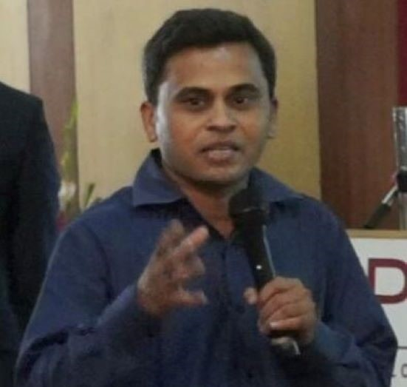






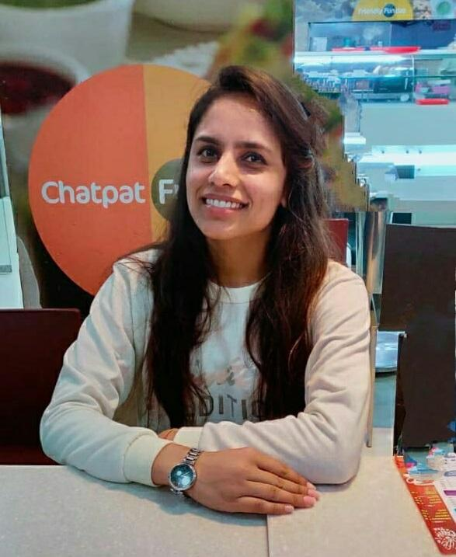
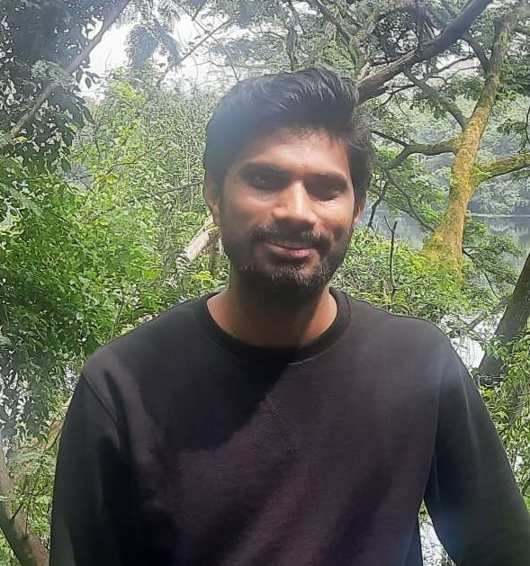

Team
Hasmukh Parekh
Director, Strategy
Shriman Tiwari
Chief Data Scientist
Sameer Awate
Chief Technical Officer
Vivek Agarwal
Technical Adviser
Parag Khandekar
COO
Manish Maurya
Data Scientist
Onkar Bhondwe
Data Scientist
Laxmi Choudhary
Data Scientist
Chaitanya Tompe
Data Engineer
Rushikesh Desai
Data Scientist

Slide 21



Contact
NAGPUR OFFICE
Infosane Technologies llp Nagpur, Shop No. 168, RAJAT SANKUL Opp. S.T. Stand, Near Hotel Rahul Deluxe GANESH PETH, Nagpur, Maharashtra 441108,India
PUNE OFFICE
FlairMinds Software Pvt. Ltd. 11, Soormani, 163 D.P.Road, Aundh, Pune, opposite DAV School, 411007, India
sales@flairminds.com
+91 9967 650 472
FlairMinds
Confidential - Work Document

